Slide 1
Website Analysis Presentation

Slide 2
Introduction
Our Project “Easy Japanese”
Introduces basic Japanese language so that it will be easy for beginners to cope up with Japanese studies.
Motivates Japanese learners to carry on the studies by making it fun and simple.

Slide 3
Hardware & Software
Minimum Hardware Requirements
Memory: 1.00GB RAM or More
Additional Devices- USB Drive and Printer
Minimum Software Requirements
OS - Windows 10
Front End - HTML,CSS,JAVASCRIPT,ANGULARJS
Browser – Google Chrome

Slide 4
Objectives
Introducing basics of Japanese language making it fun and simple.
Providing information about certifications of Japanese language.
Providing helpful free study resources for Japanese language studies.
A short quiz for testing your gained knowledge.
To help you get going with Japanese studies.

Slide 5
Scope
Our website not only gives a short and basic idea about the Japanese Language for the beginners but also provides useful information to the students who are looking for extra study materials.
So we have introduced various websites, online resources available and useful for studying Japanese.
By making good use of the internet for studying new language and motivating learners who are looking for fun ways to study Japanese.

Slide 6
System Analysis
Many beginners struggle to find how to start with language learning, so to help them solve this problem we have created this website.
Those learners who are already studying the language but want to find out appropriate materials for study purpose as well as for extra learning our website solves that problem.

Slide 7
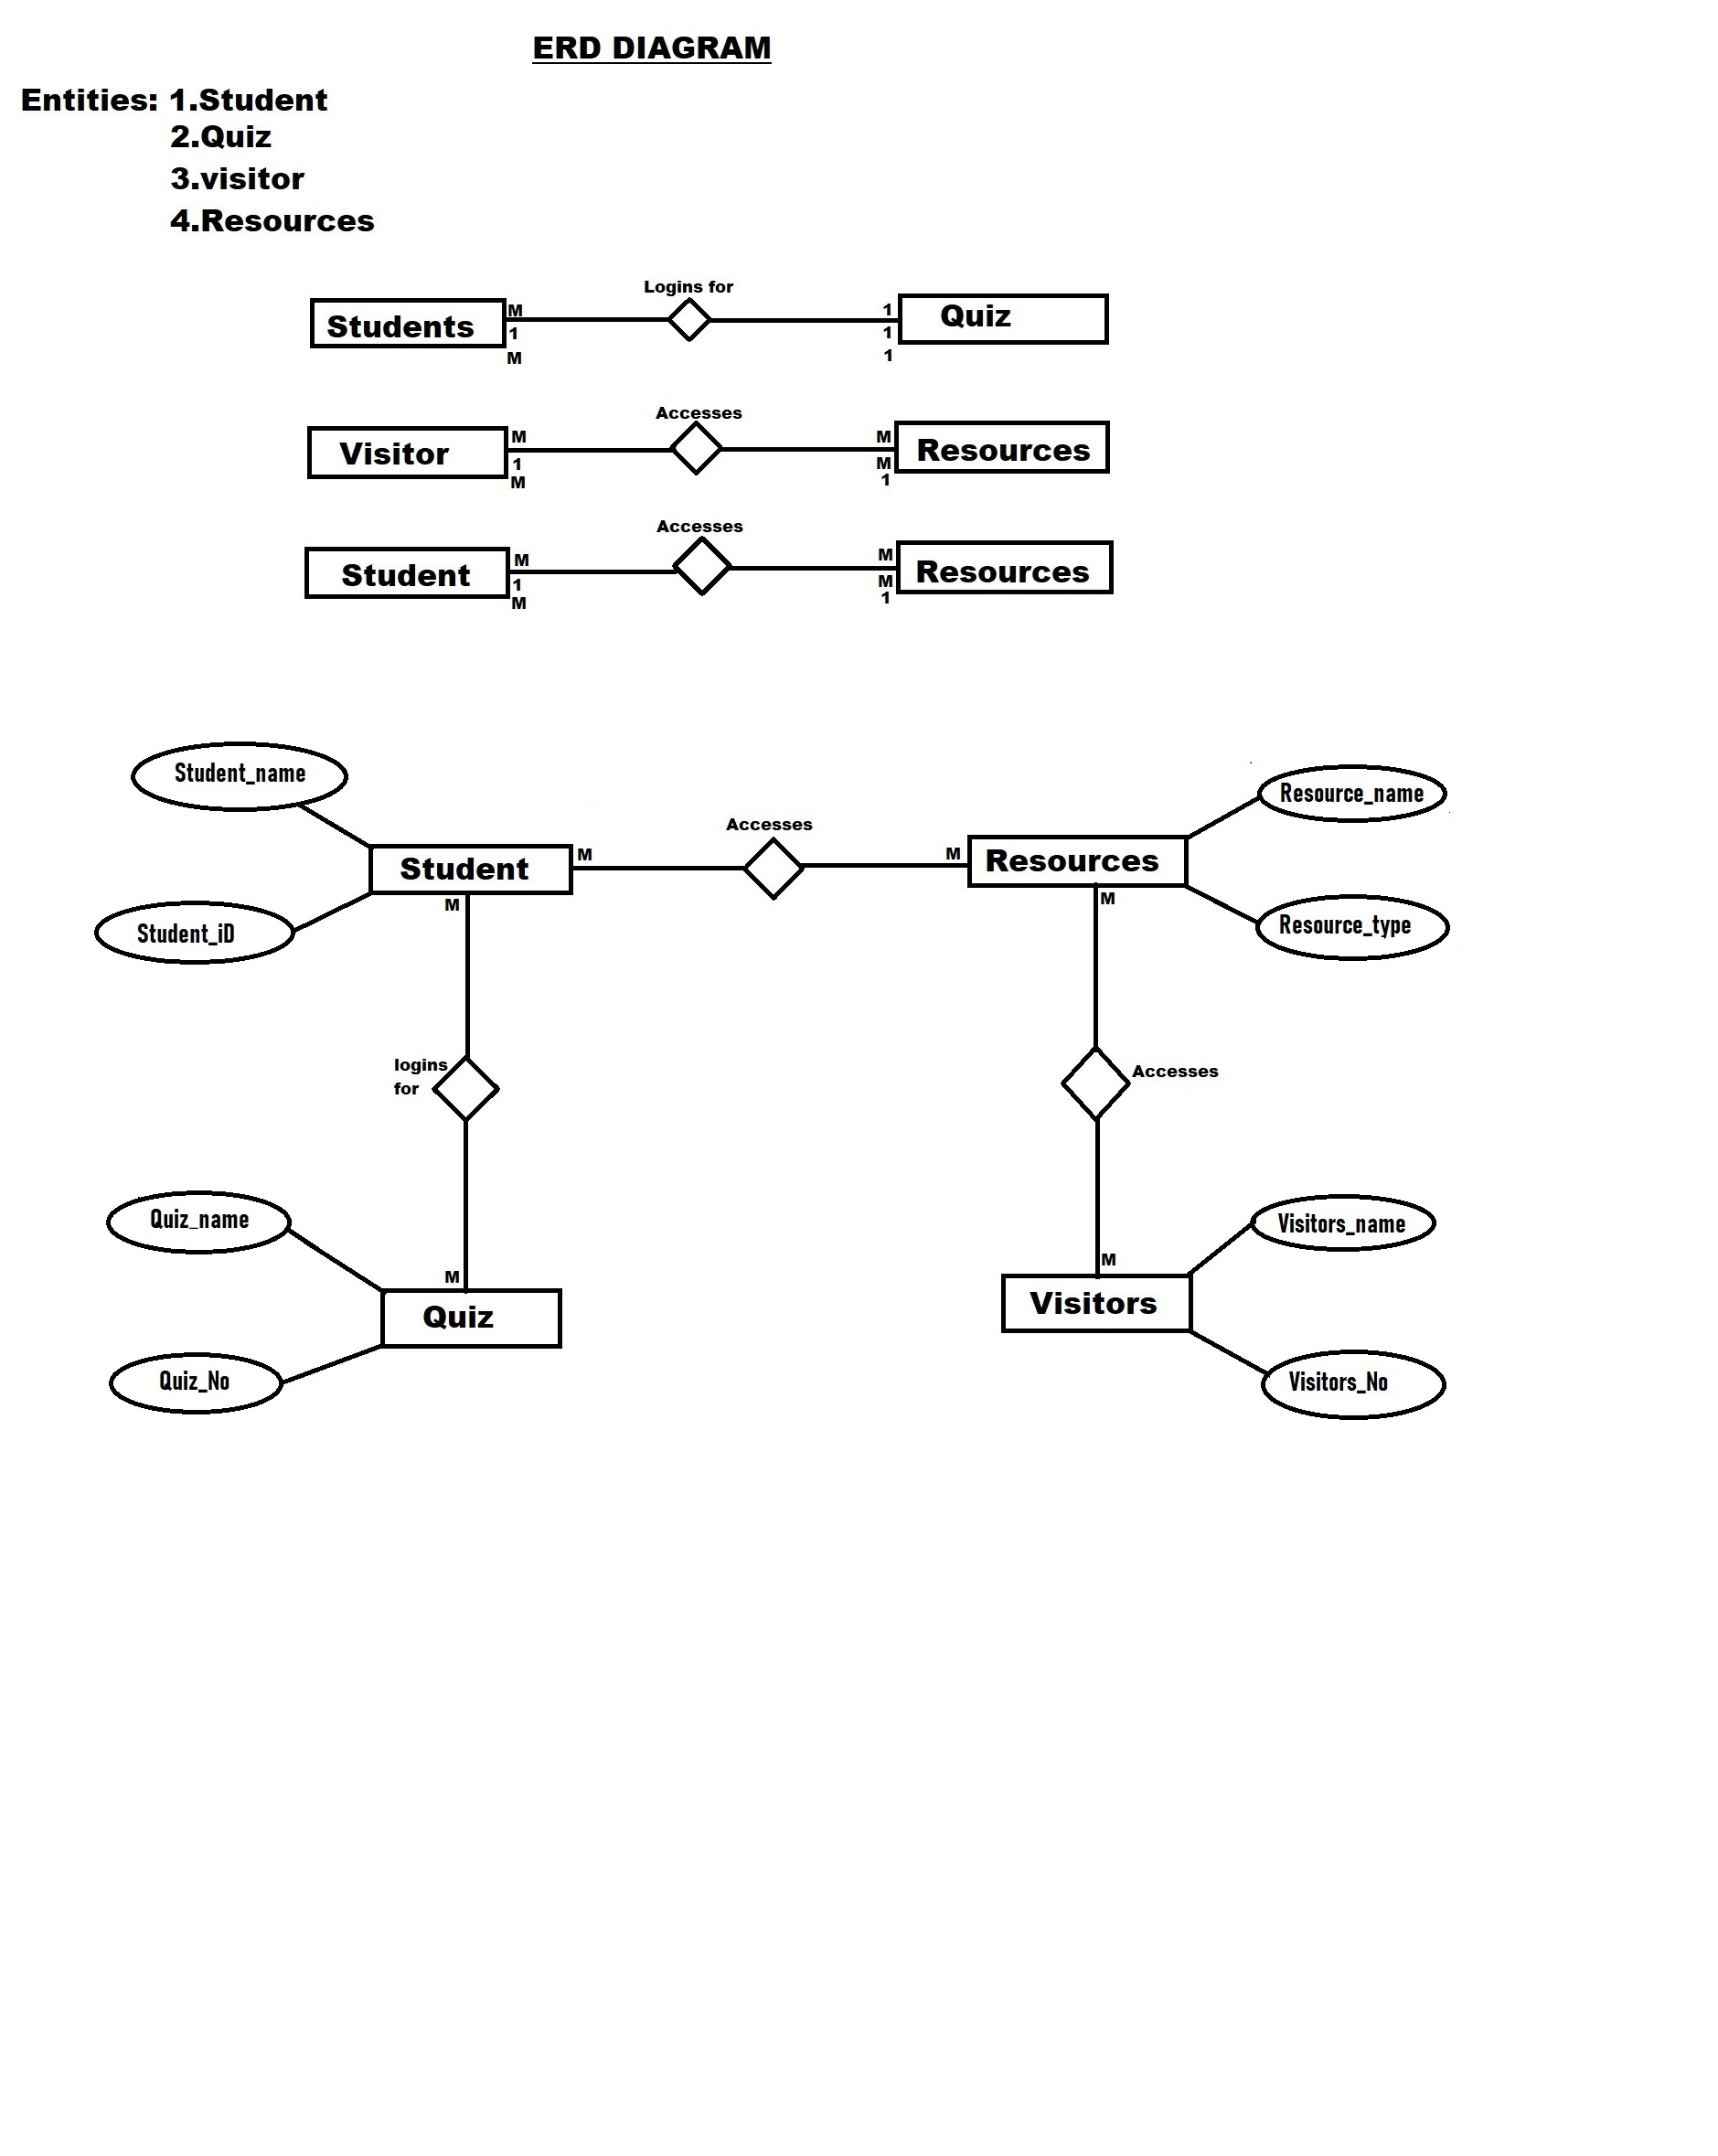
System Design
ENTITY RELATIONSHIP DIAGRAM

Slide 8
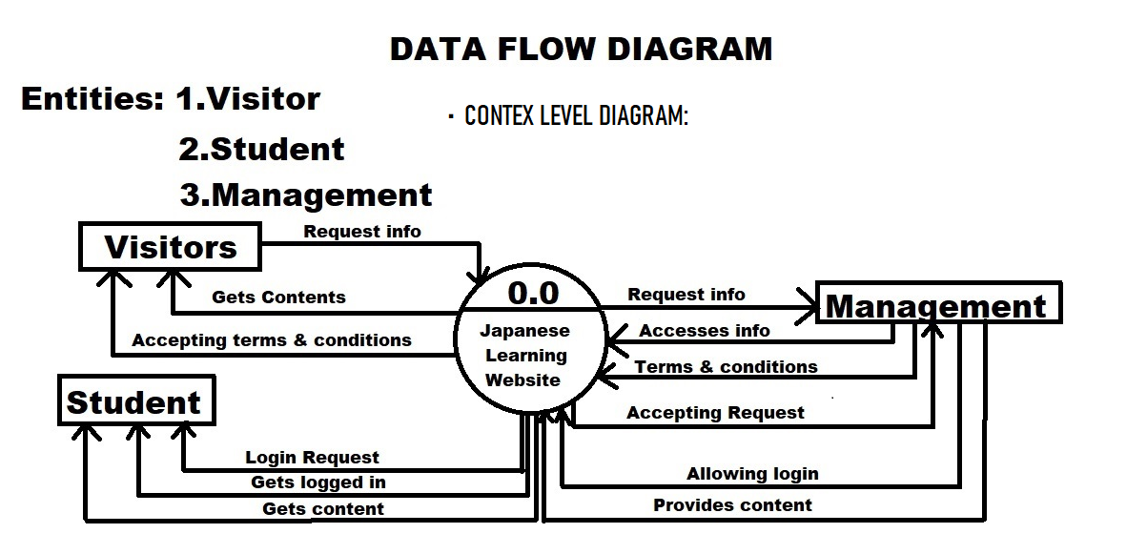
DATA FLOW DIAGRAM

Slide 9
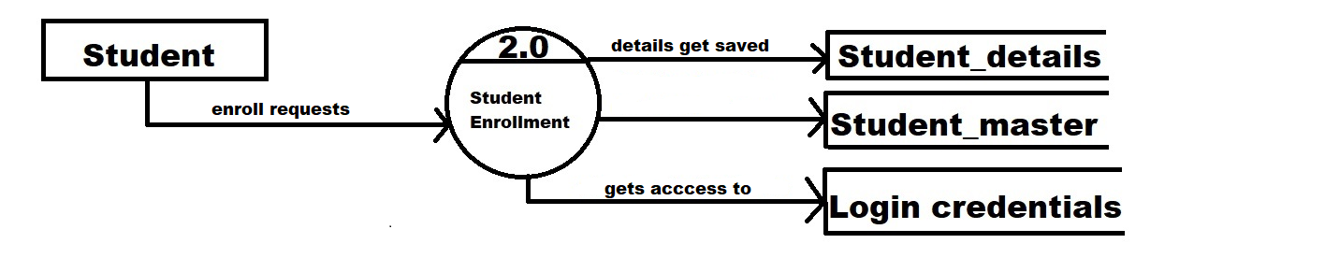
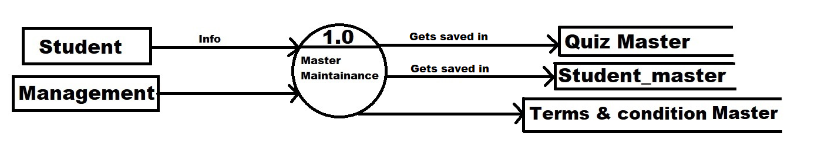
1st Level DFD
2nd Level DFD

Slide 10
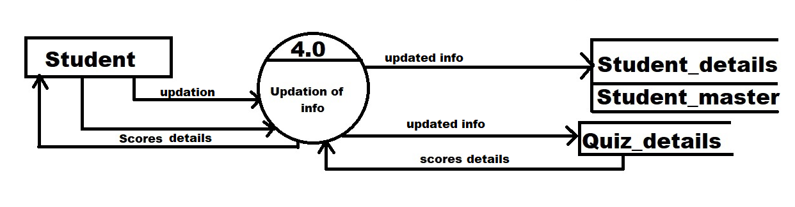
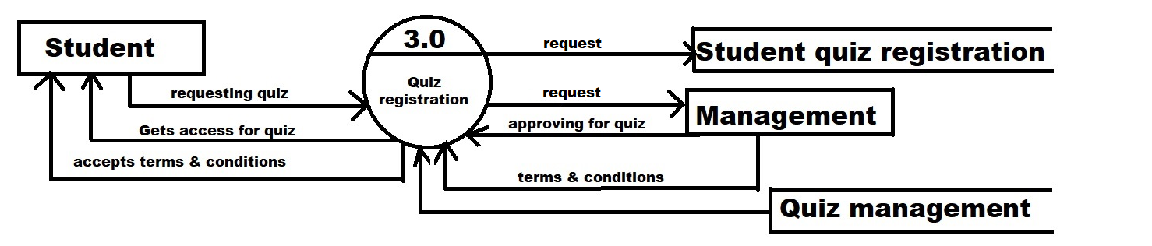
3rd Level DFD
4th Level DFD

Slide 11
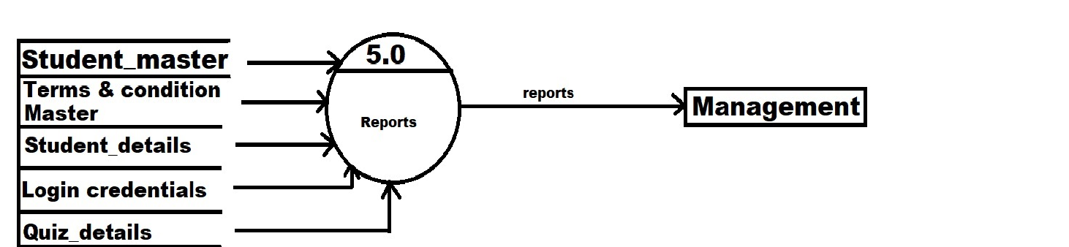
5th Level DFD

Slide 12
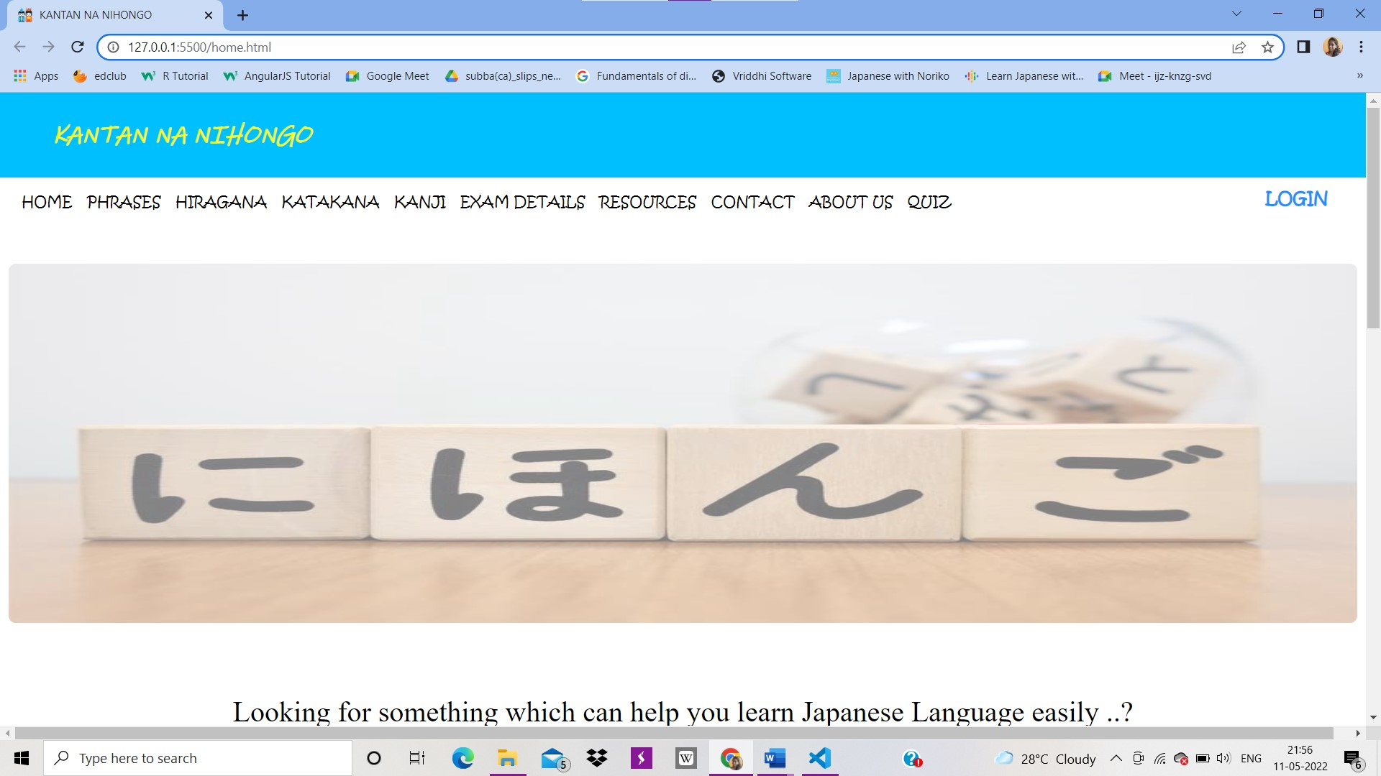
Project analysis slide 2
Website Layout
Homepage

Slide 13
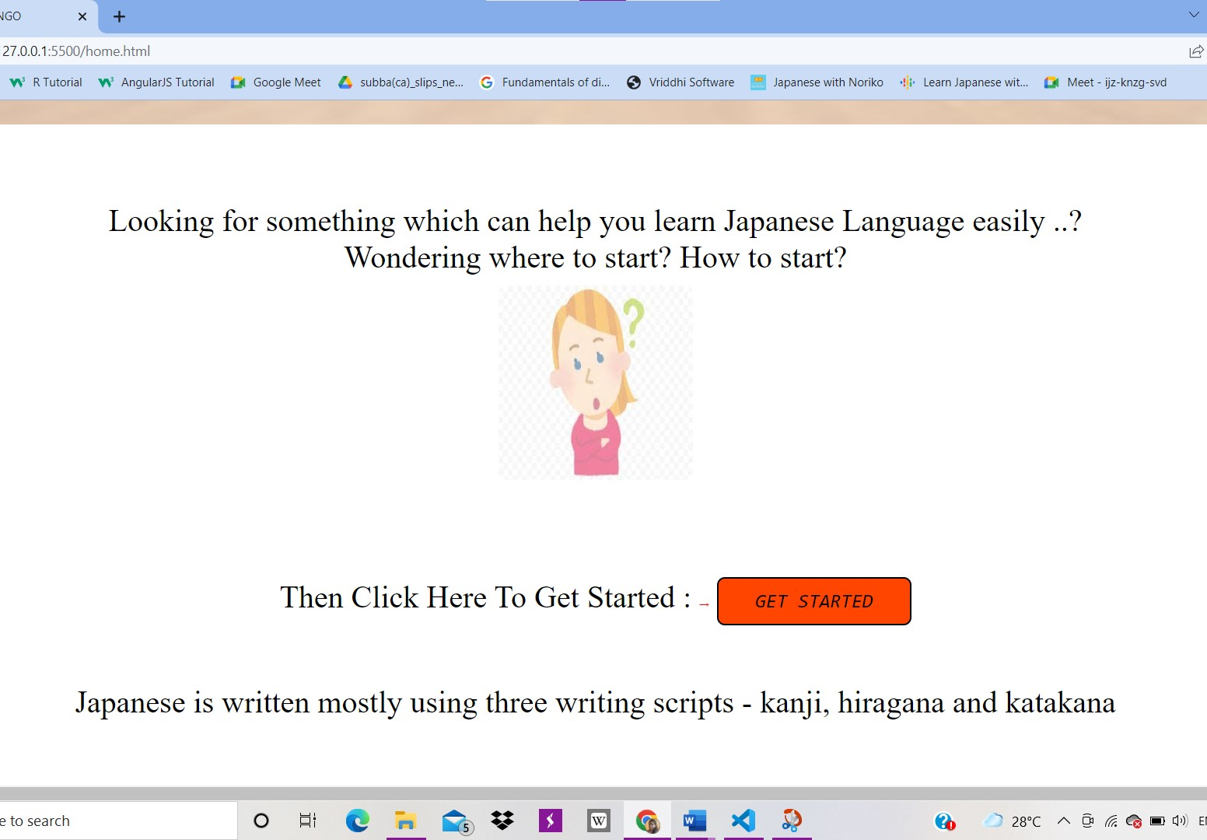
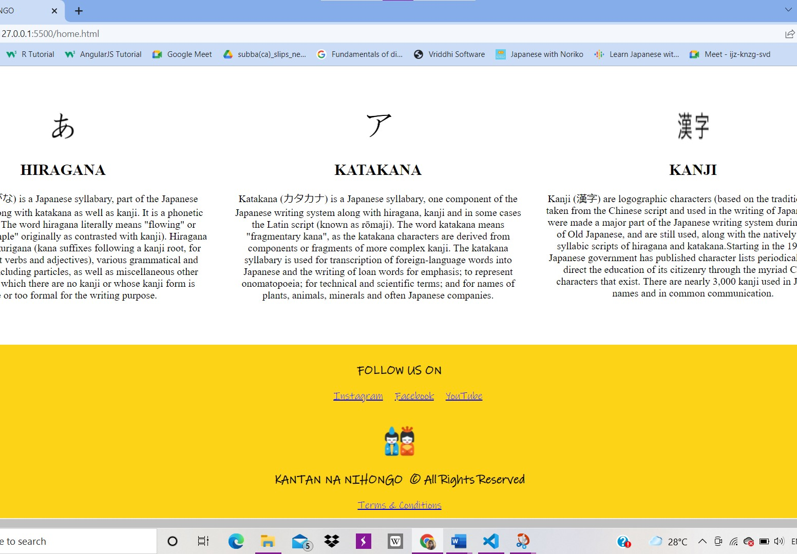

Slide 14
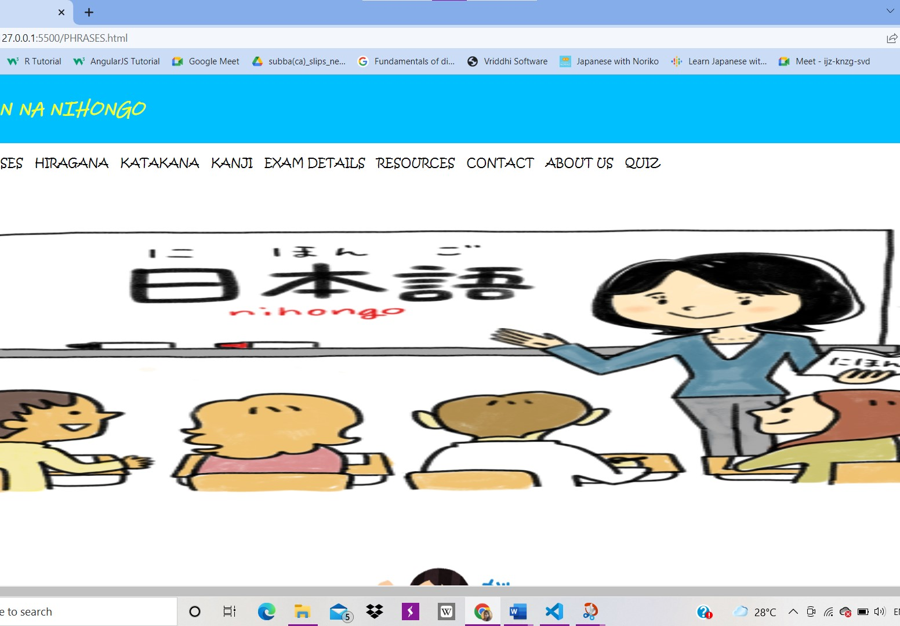
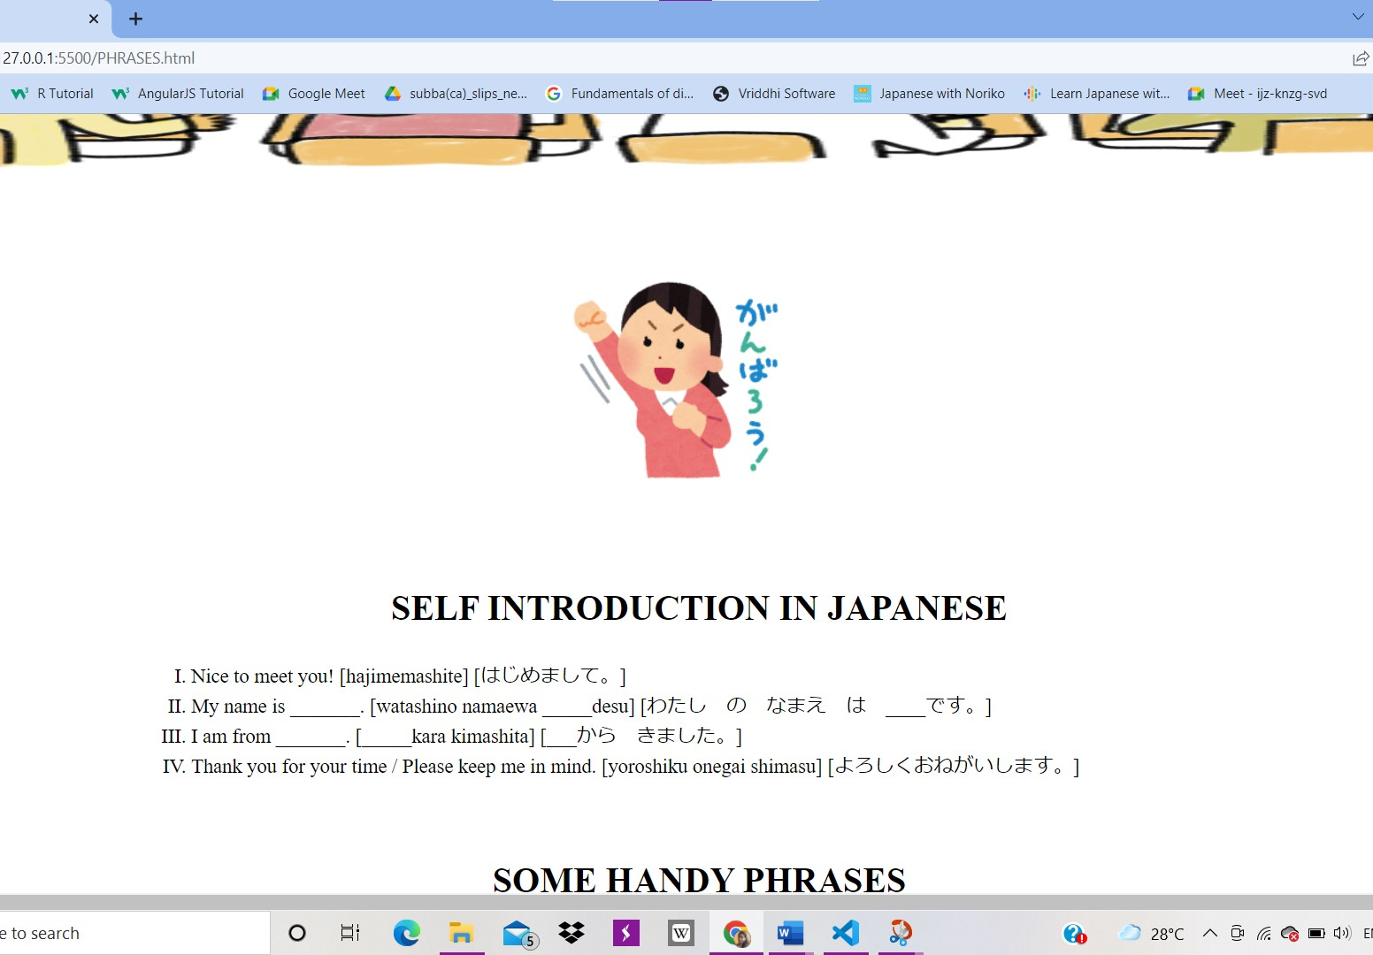
Project analysis slide 2
Phrases

Slide 15
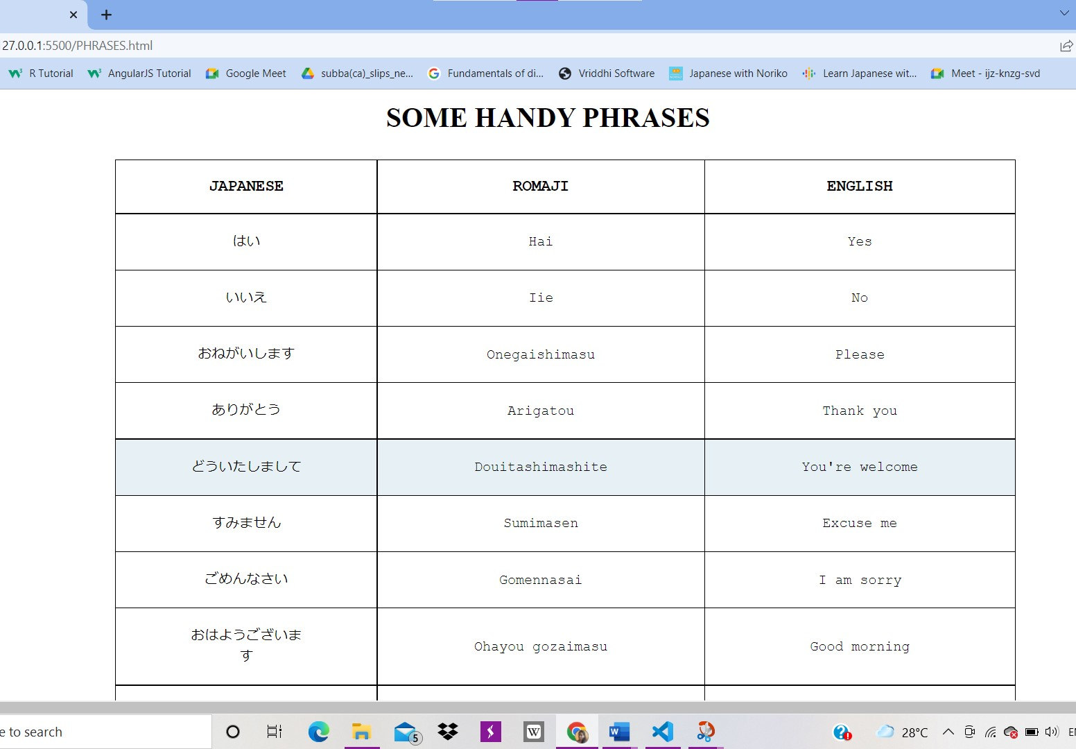
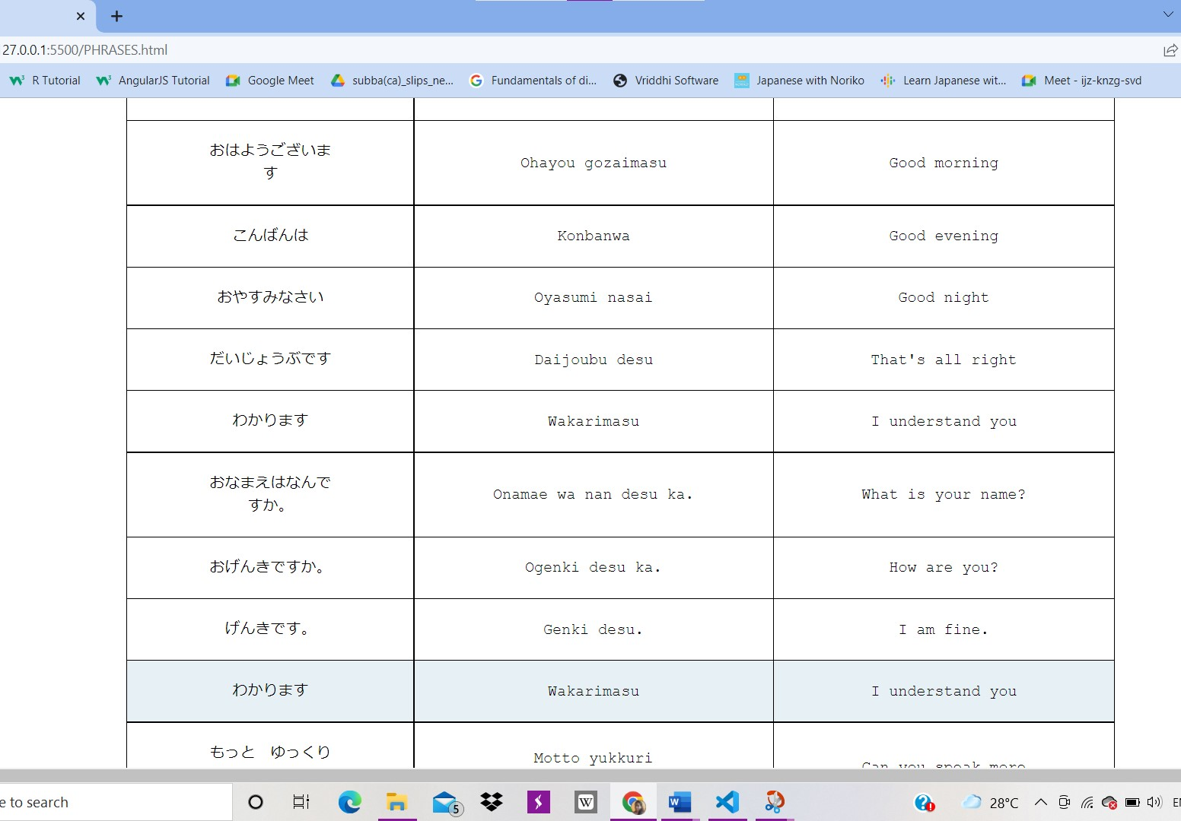
Project analysis slide 2

Slide 16
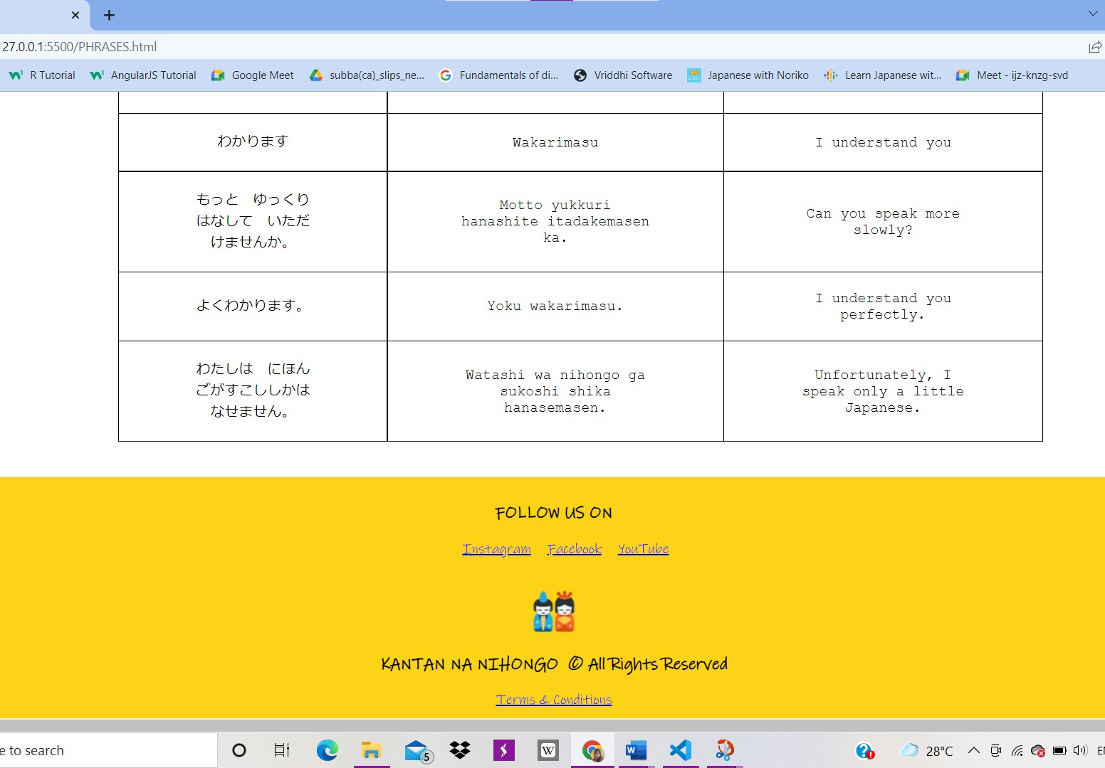
Project analysis slide 2

Slide 17
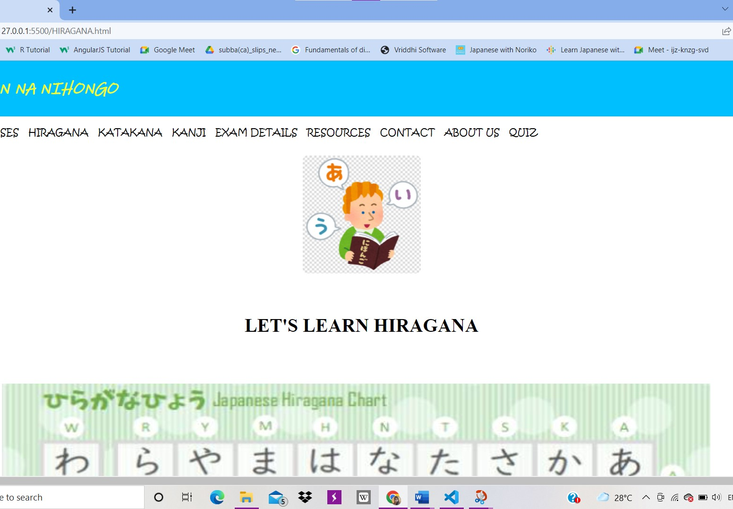
Project analysis slide 2
Hiragana

Slide 18
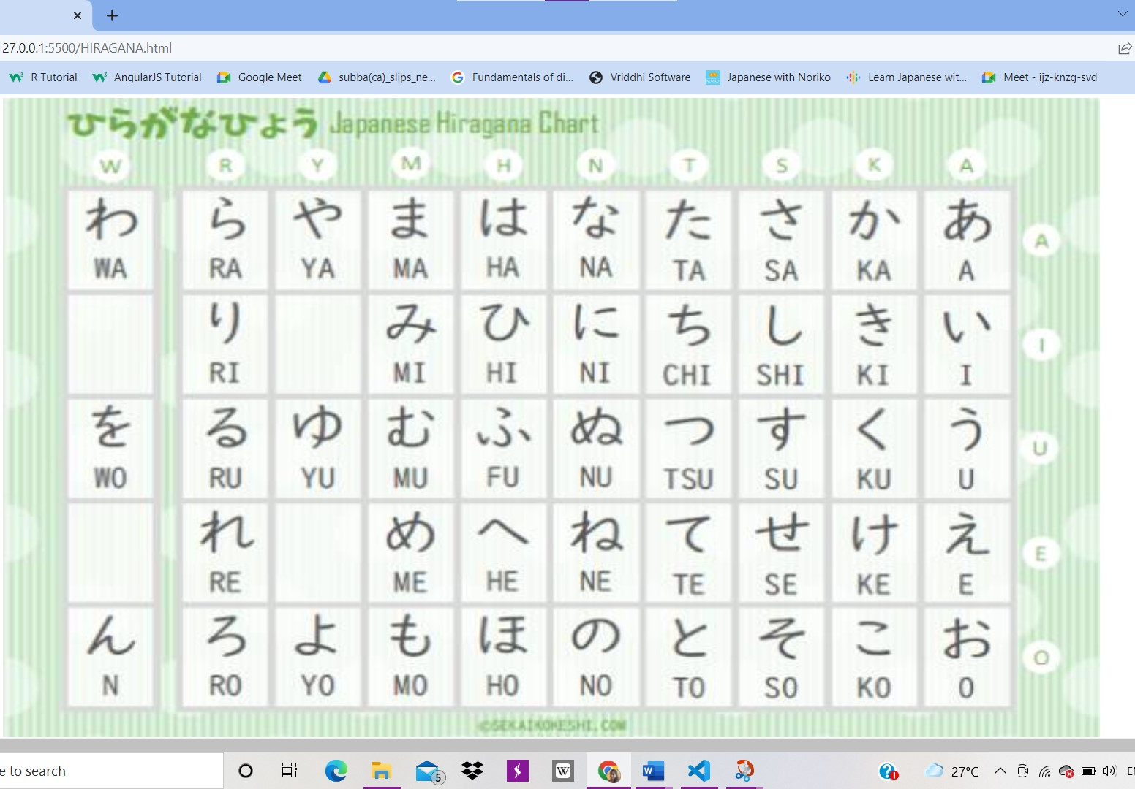
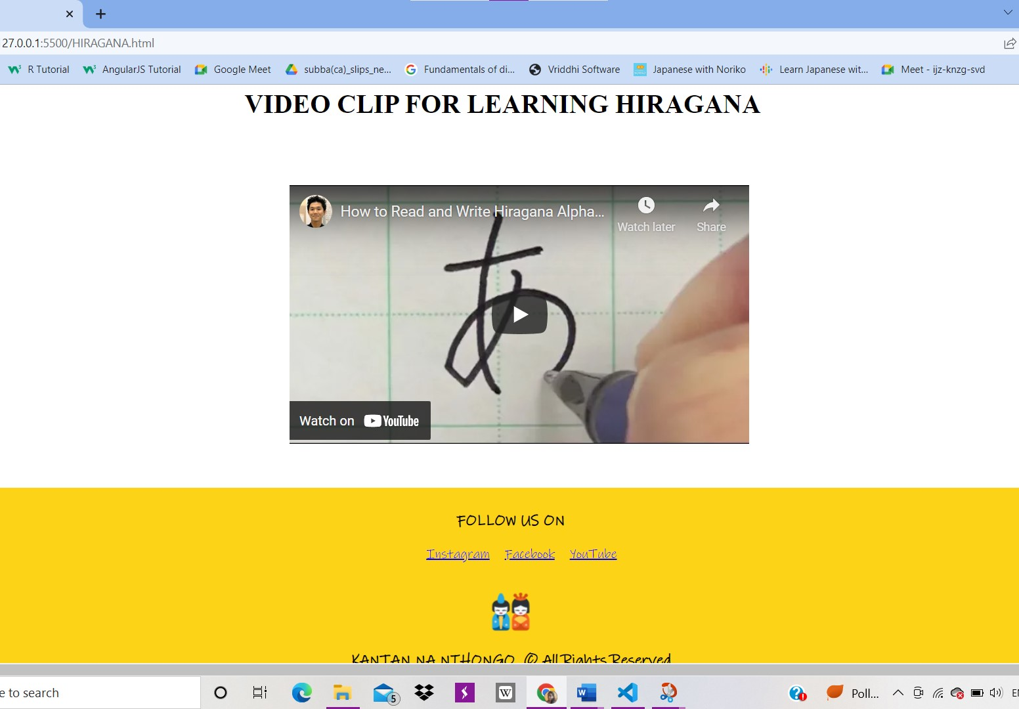

Slide 19
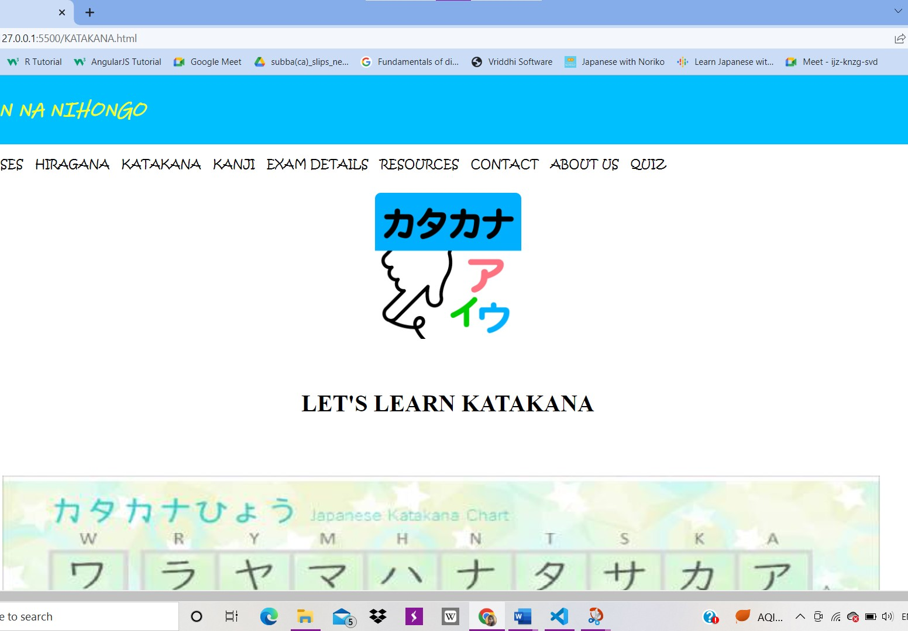
Project analysis slide 2
Katakana

Slide 20
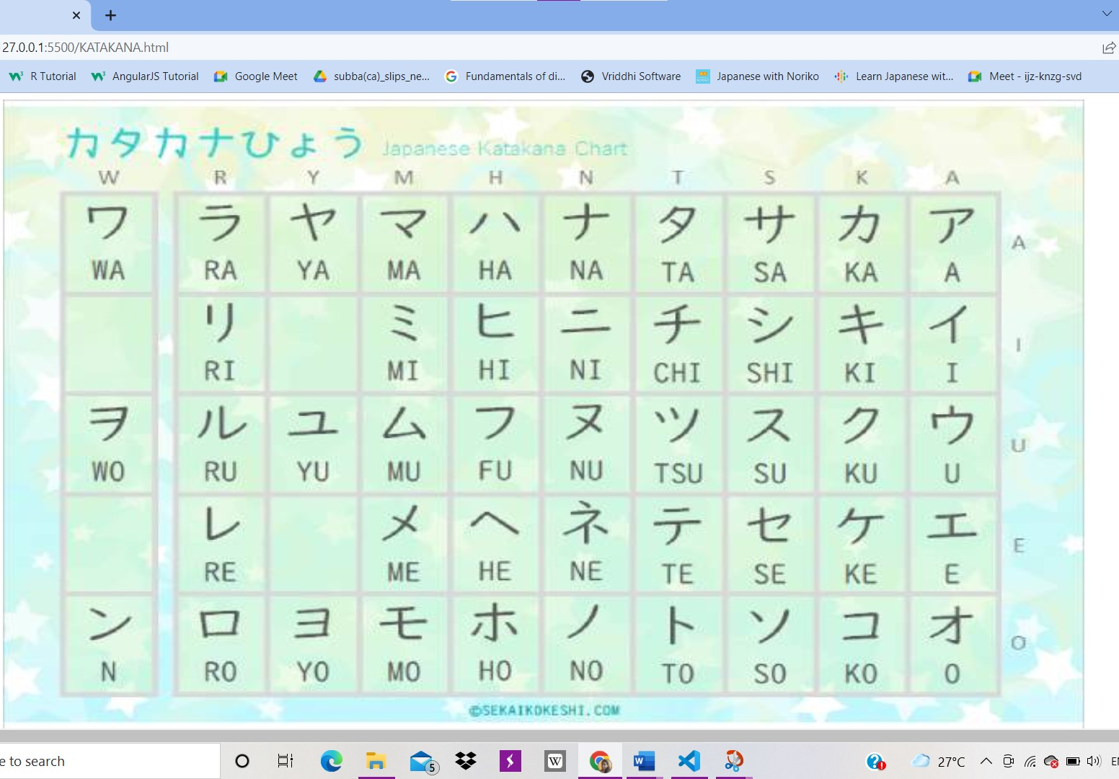
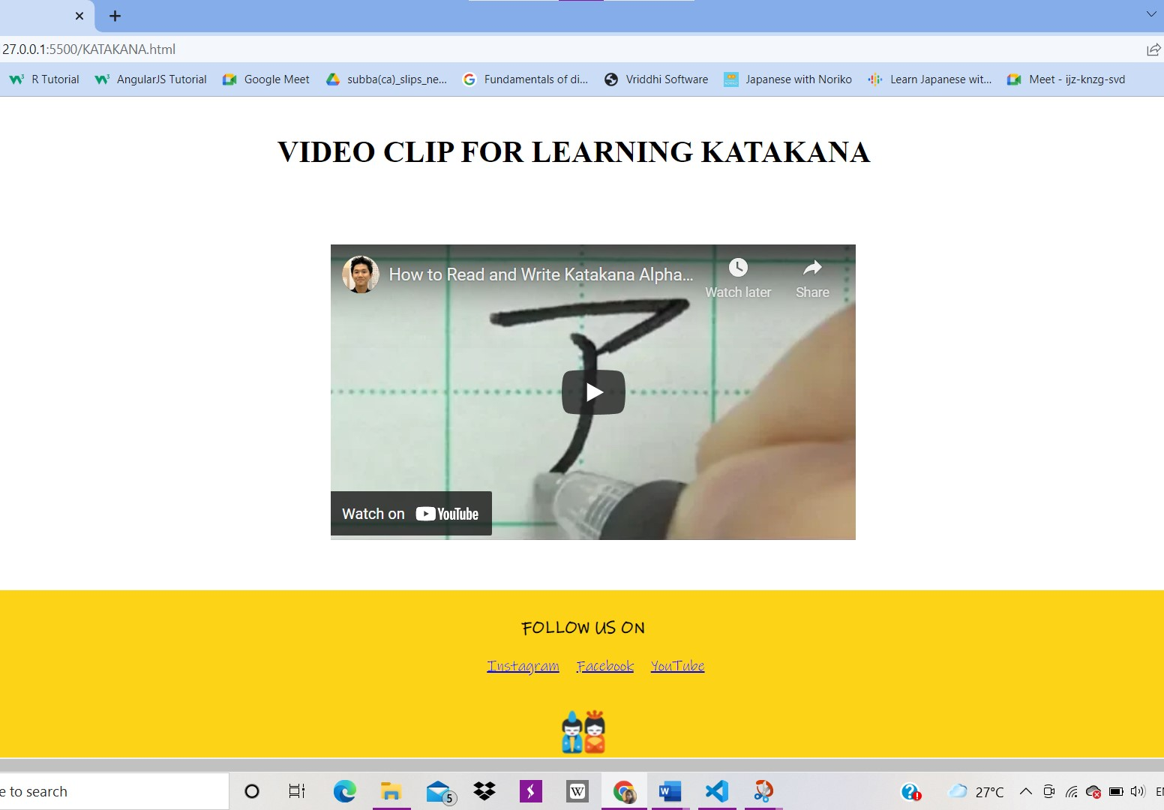

Slide 21
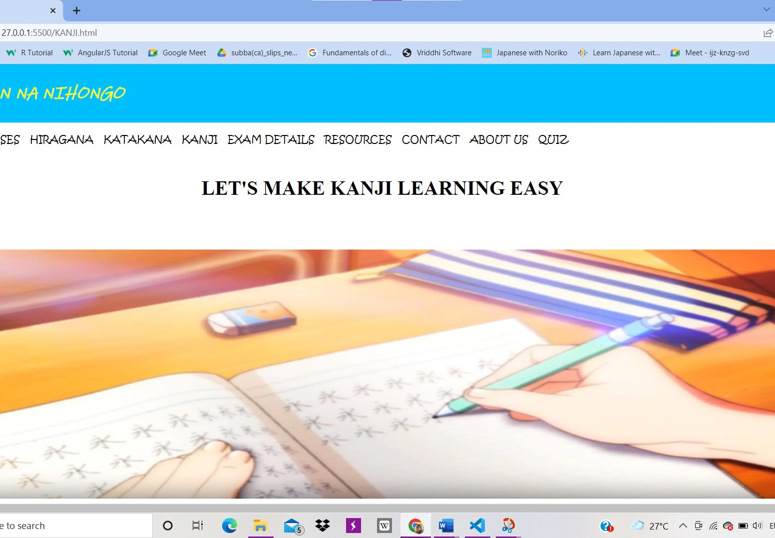
Project analysis slide 2
Kanji

Slide 22
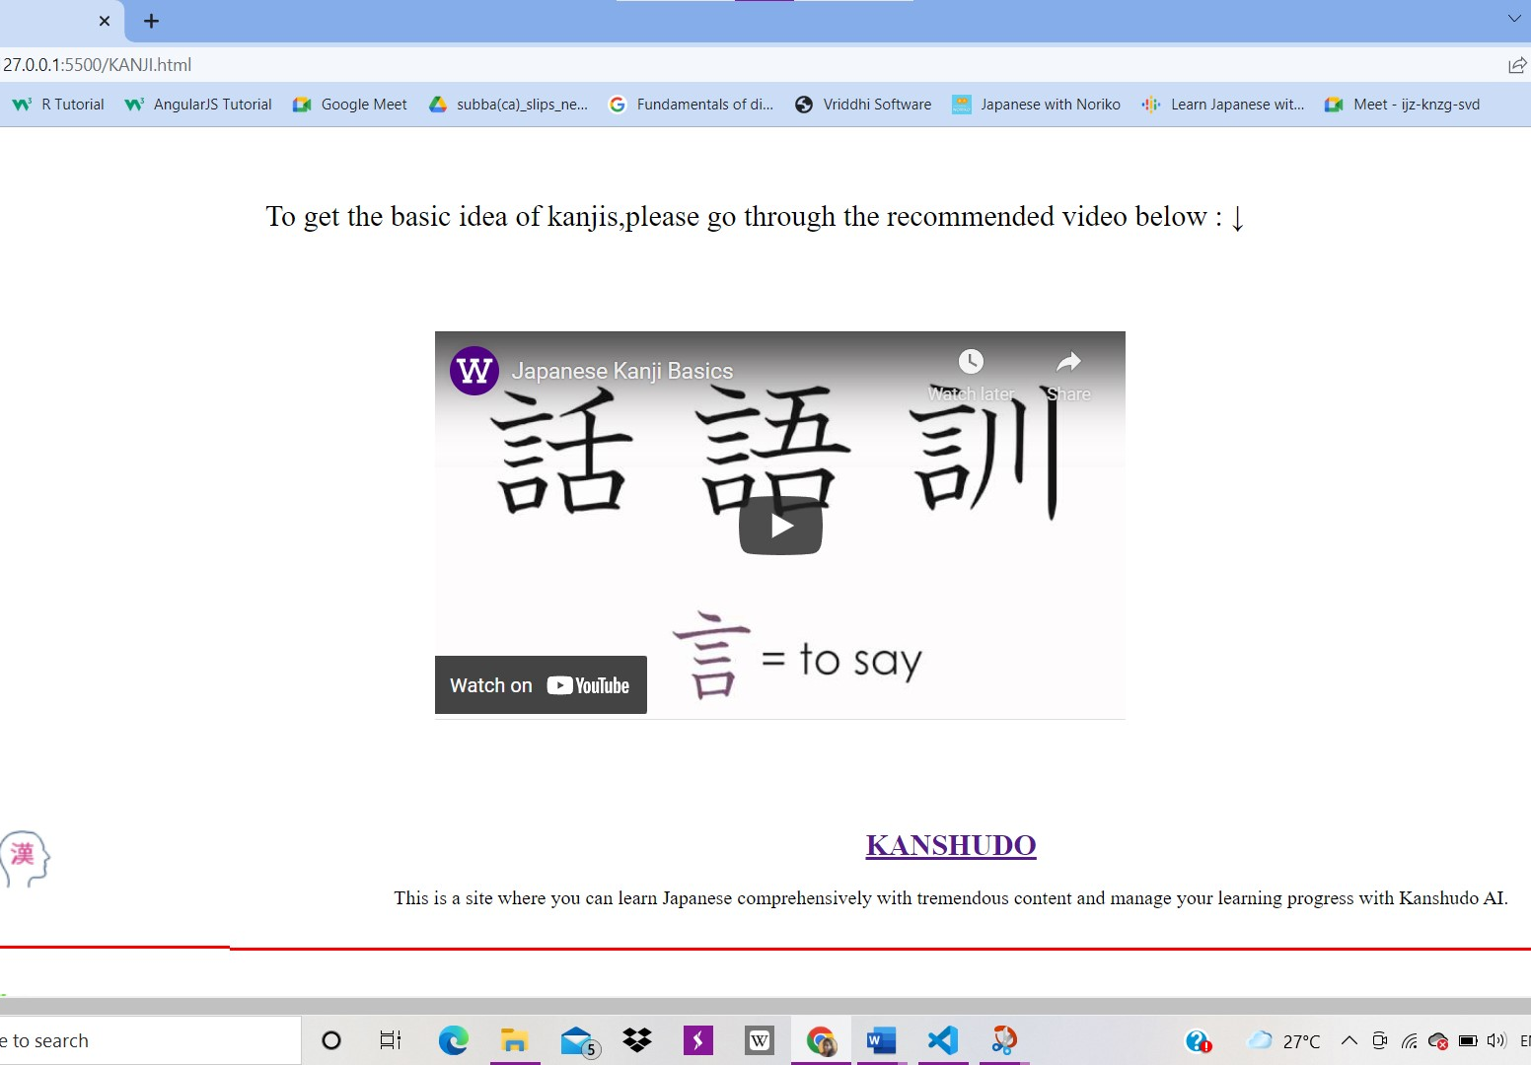
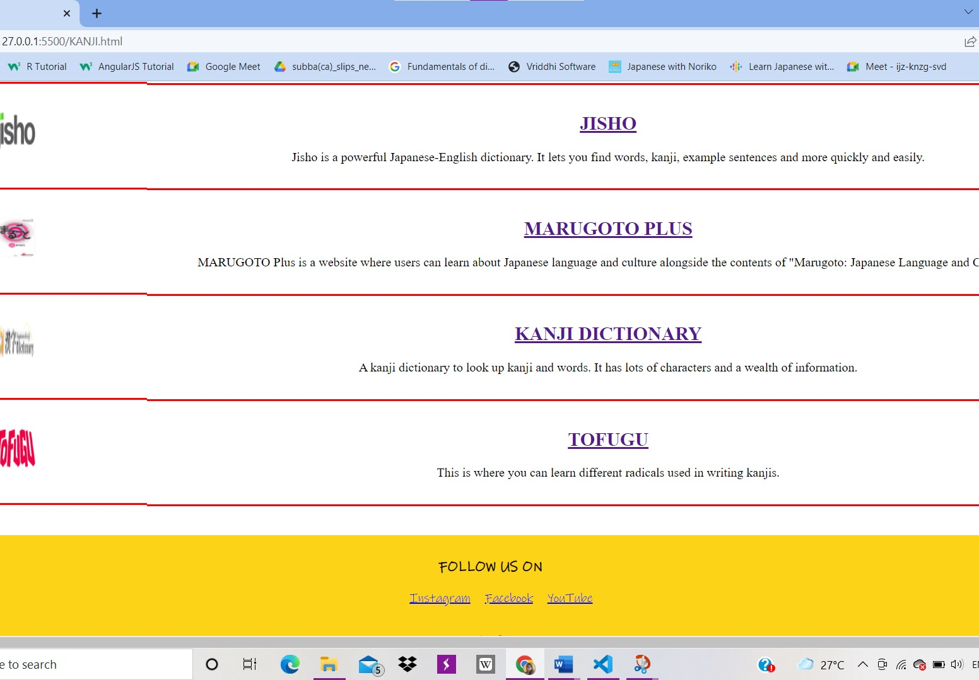

Slide 23
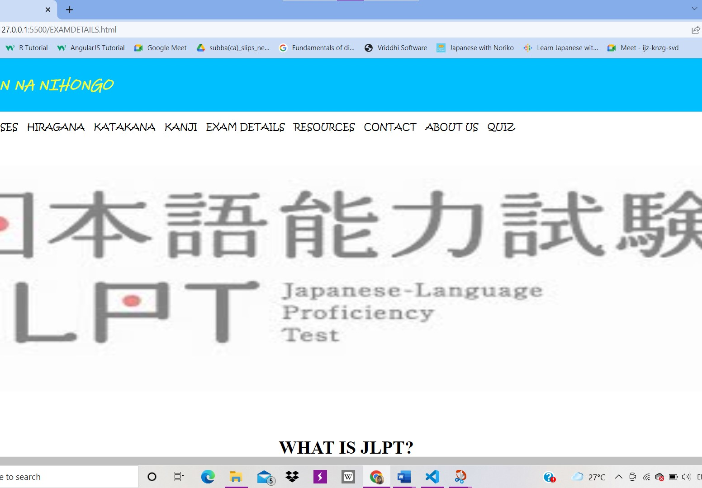
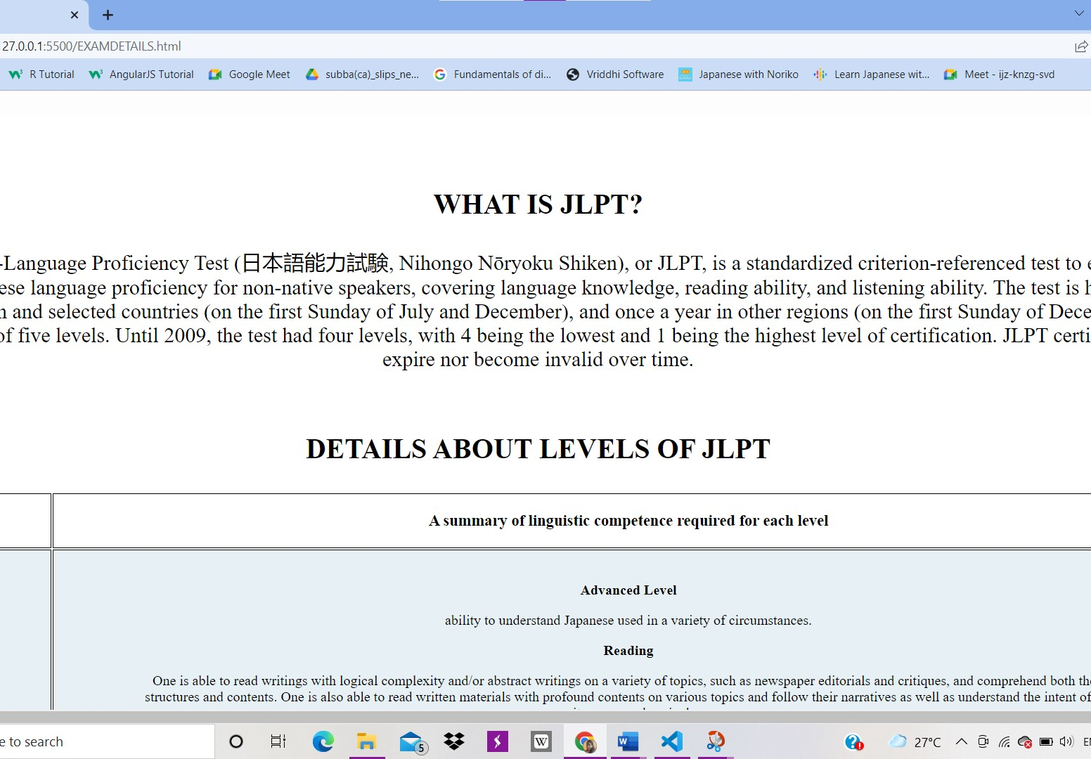
Project analysis slide 2
Exam Details

Slide 24
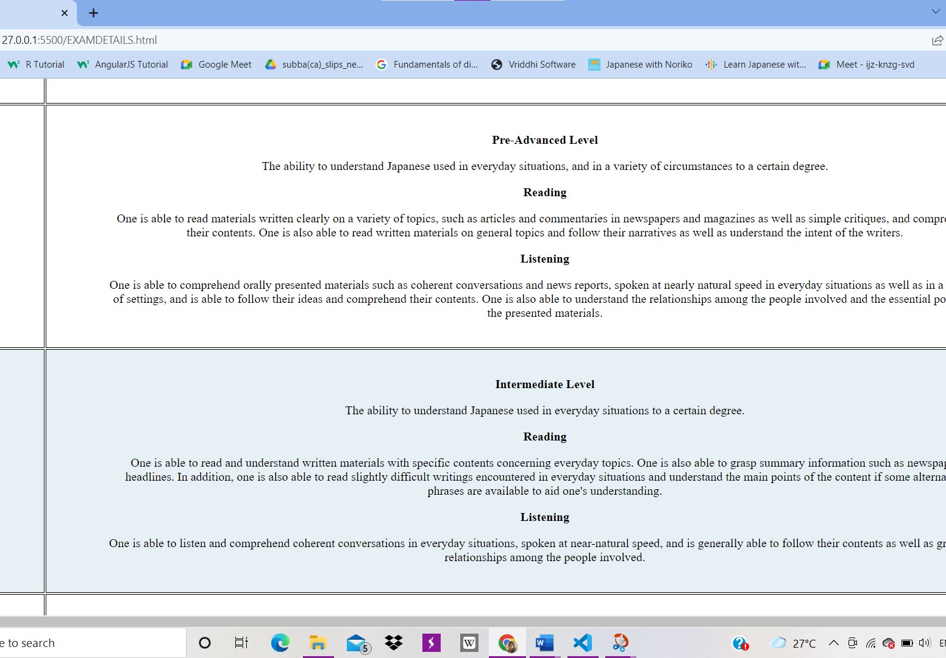
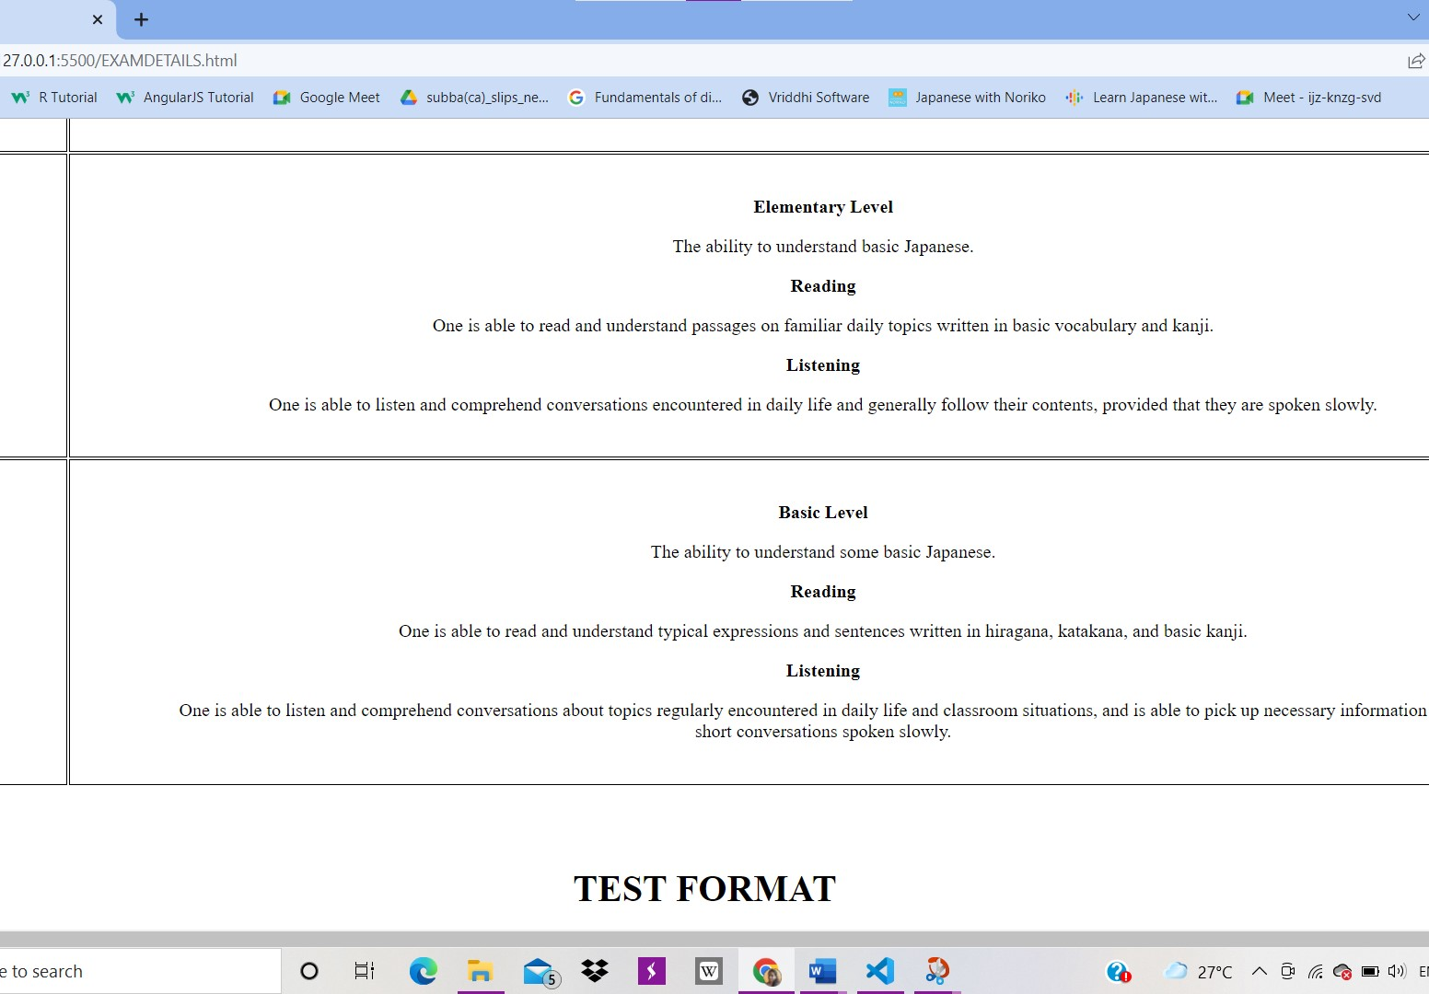
Project analysis slide 2

Slide 25
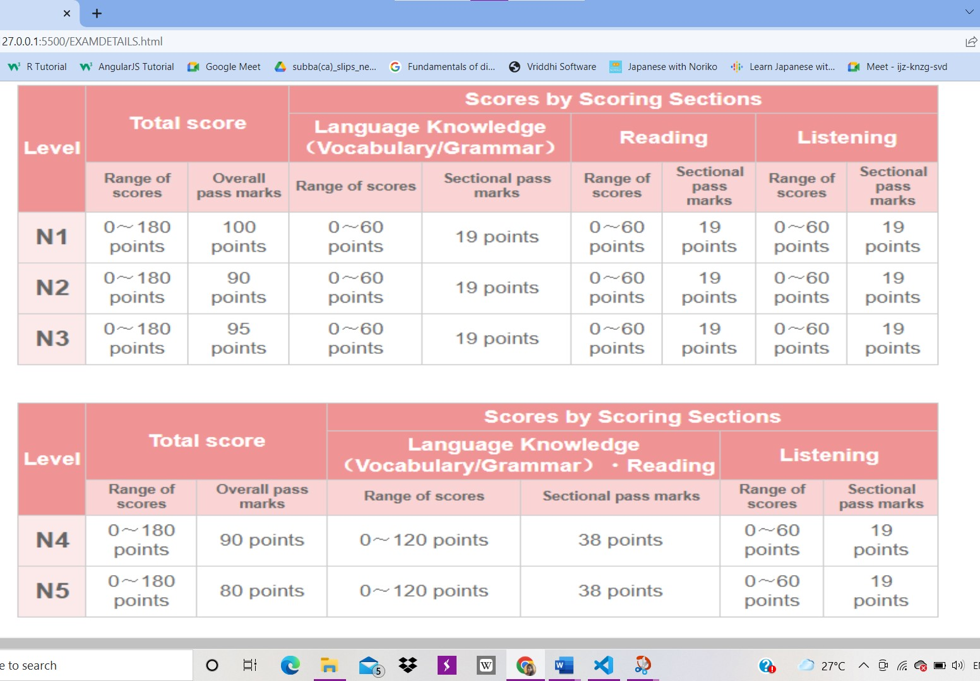
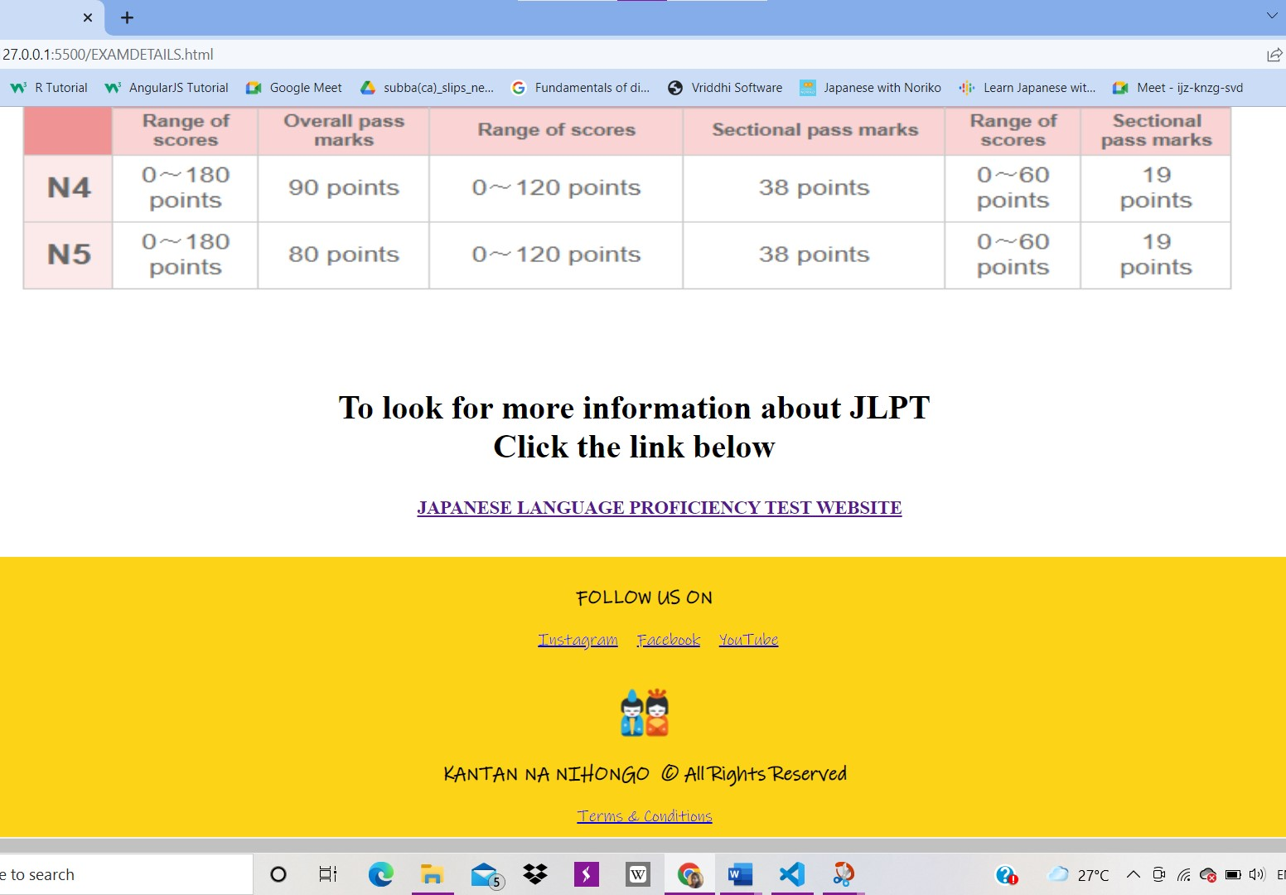
Project analysis slide 2

Slide 26
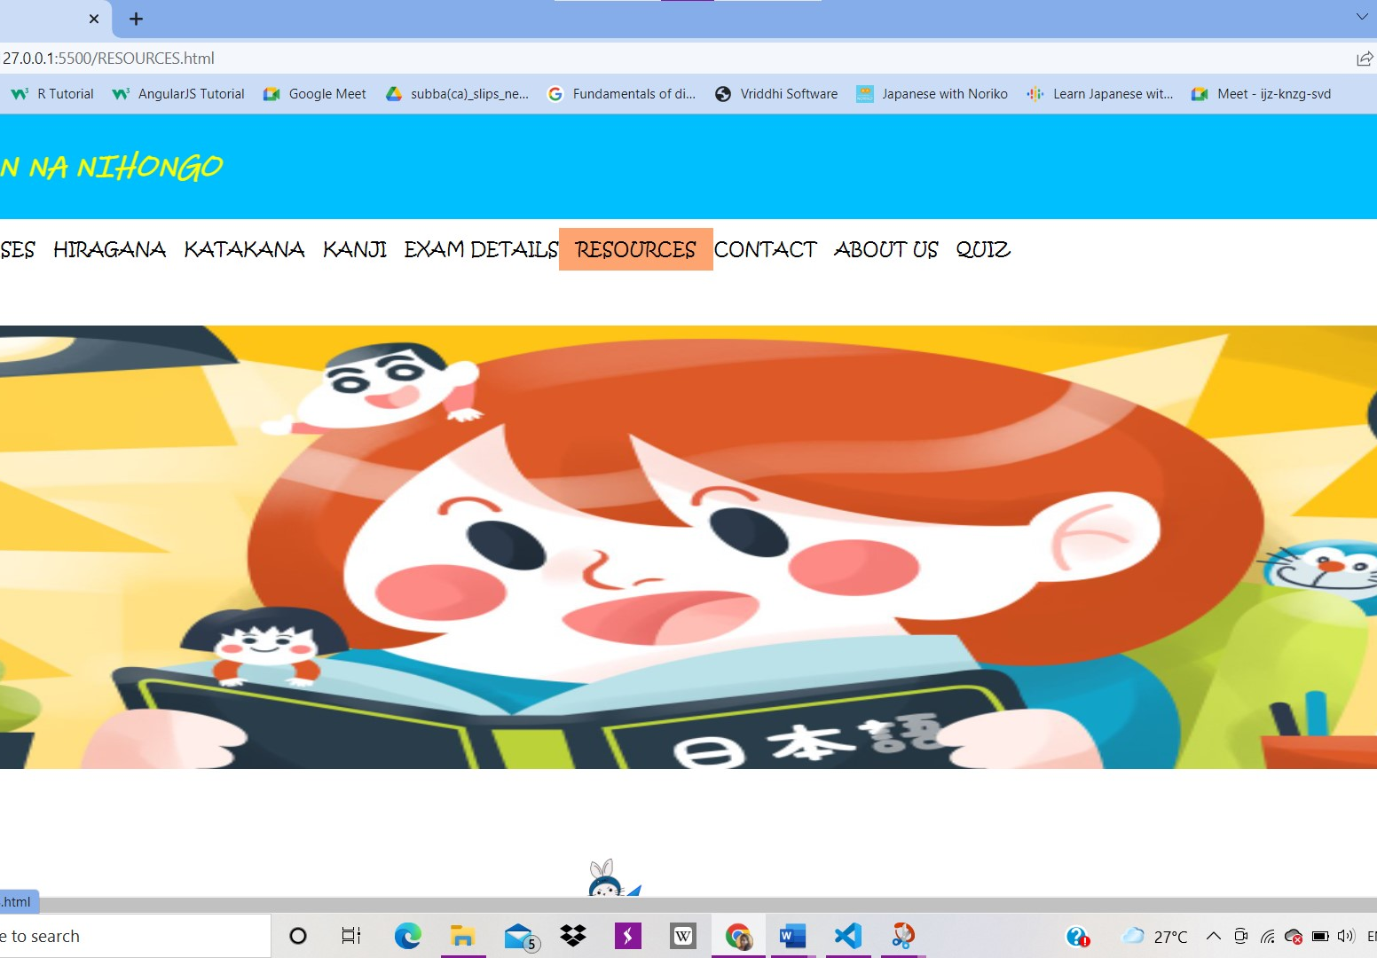
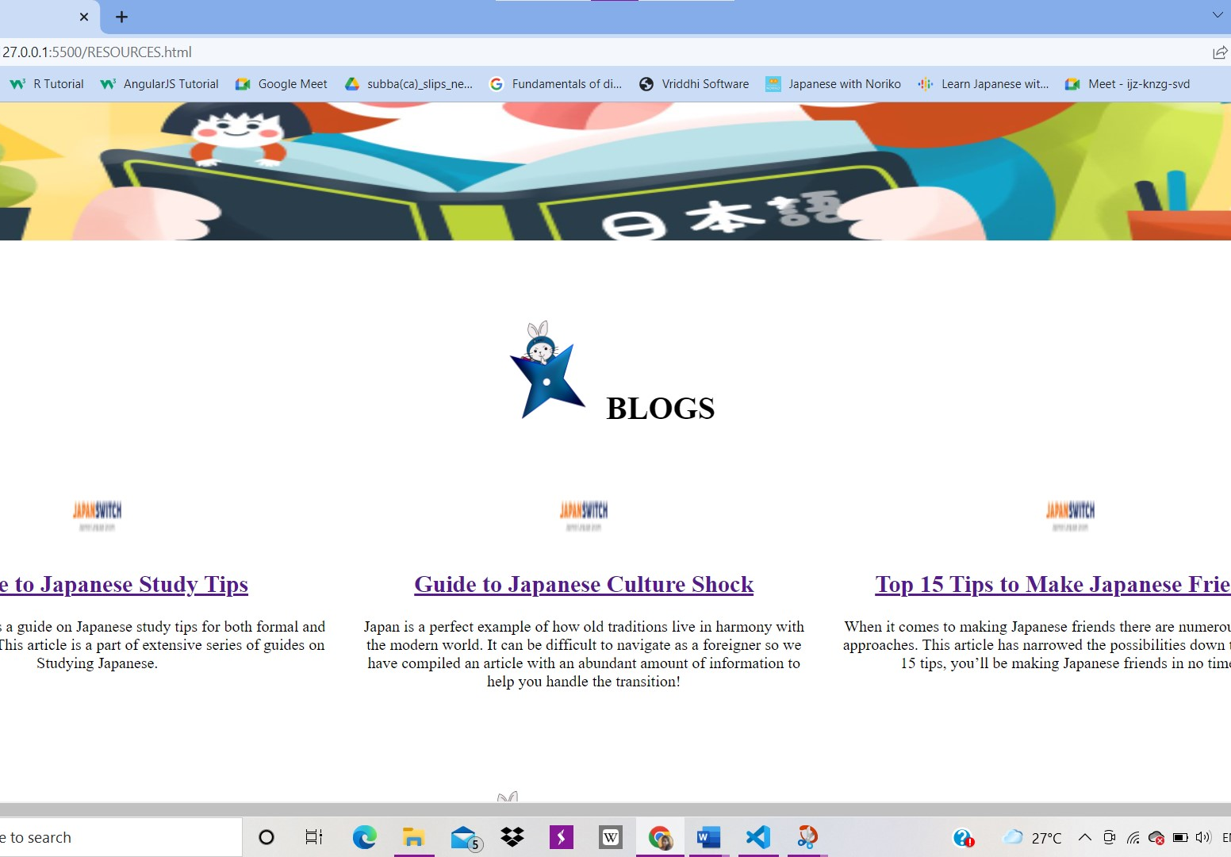
Project analysis slide 2
Resources

Slide 27
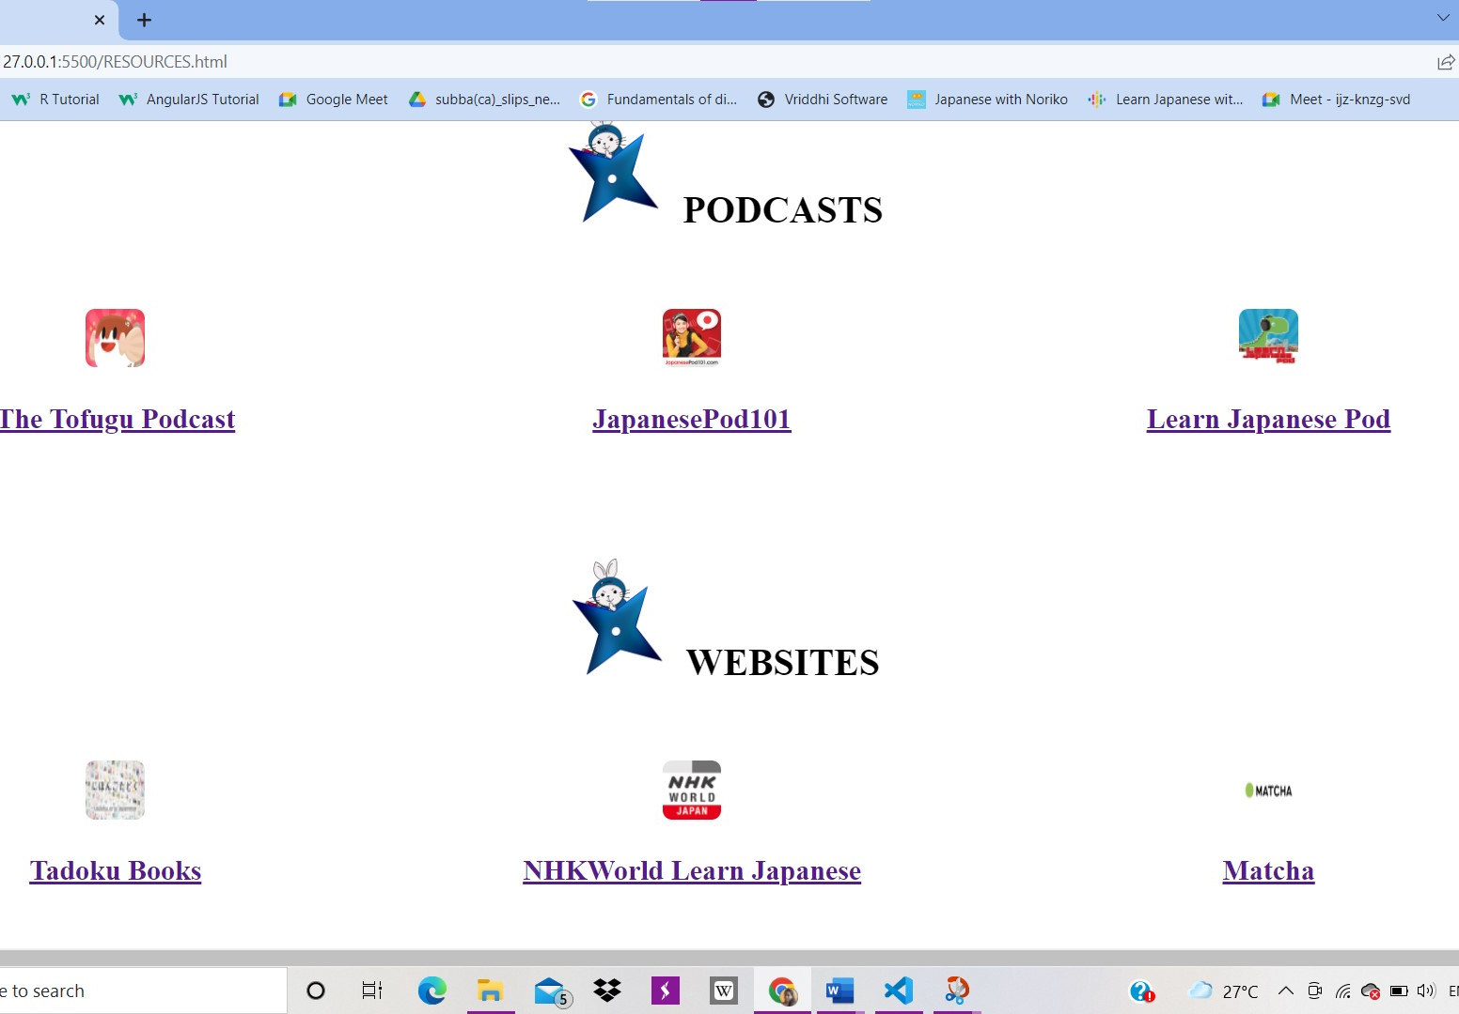
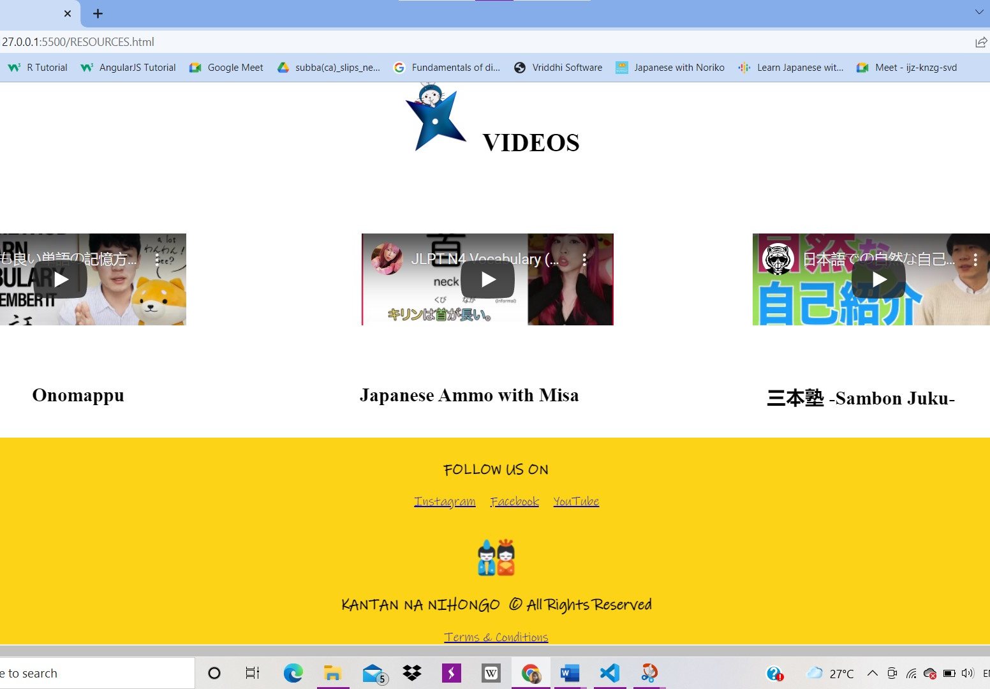

Slide 28
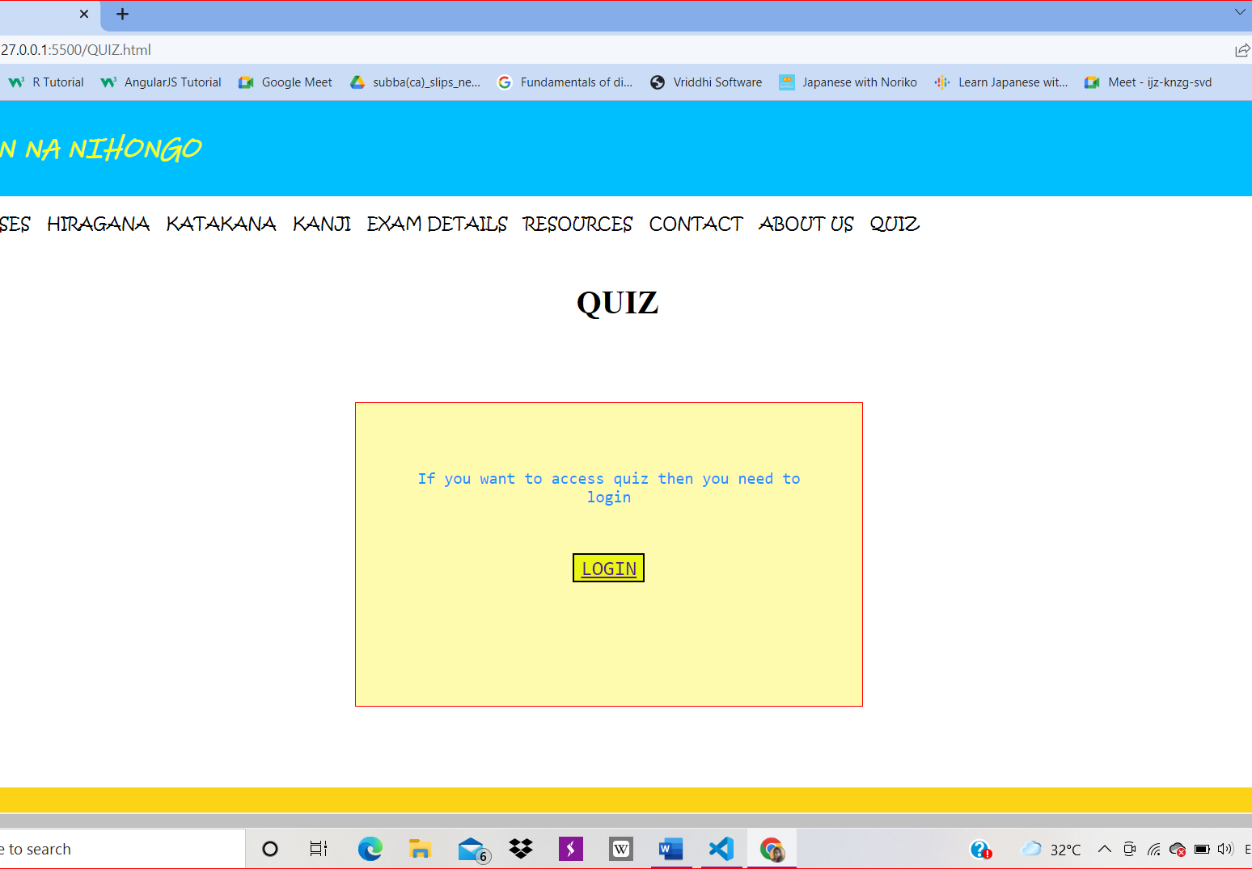
Project analysis slide 2
Quiz

Slide 29
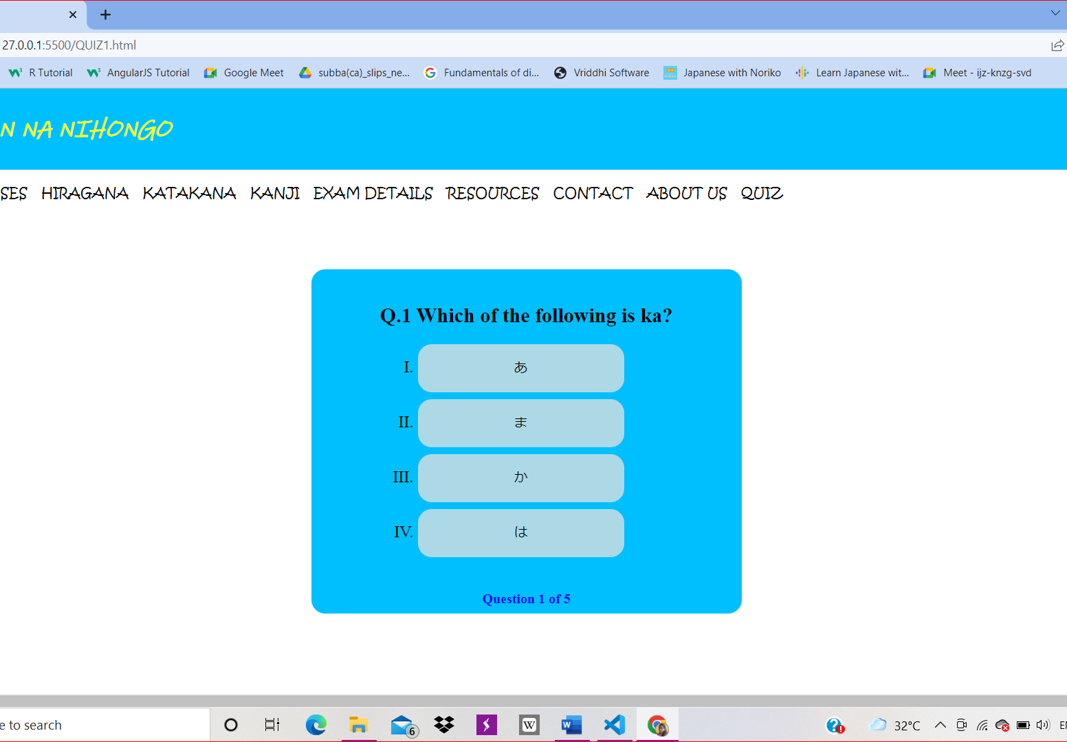
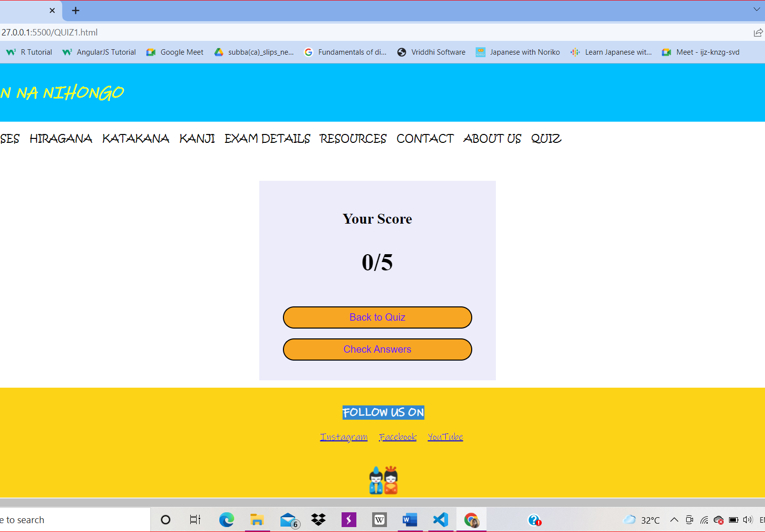

Slide 30
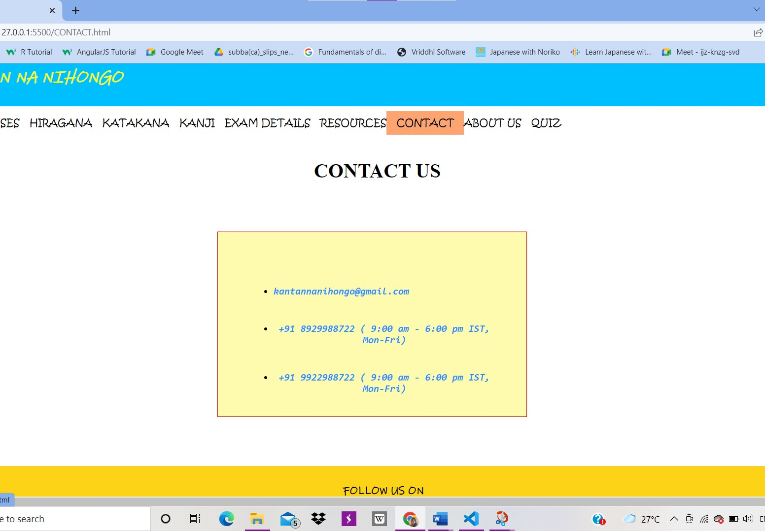
Project analysis slide 2
Contact

Slide 31
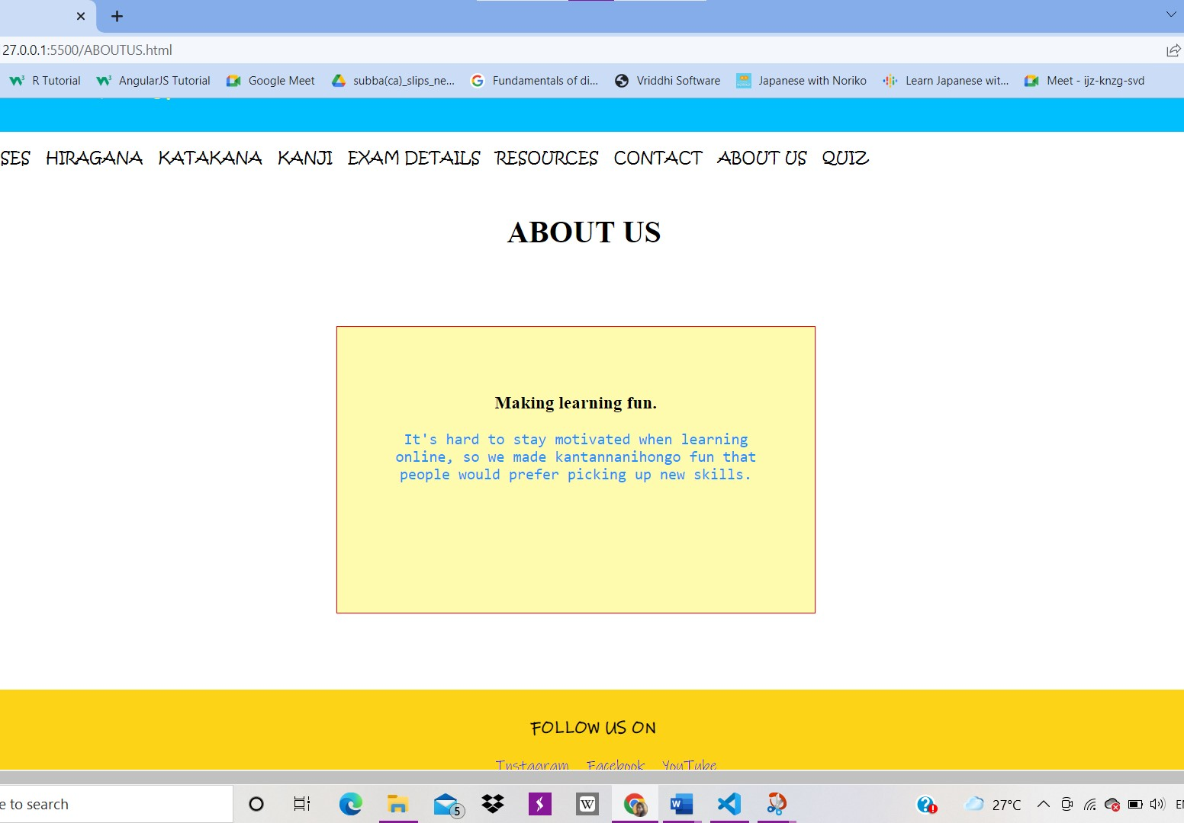
Project analysis slide 2
About Us

Slide 32
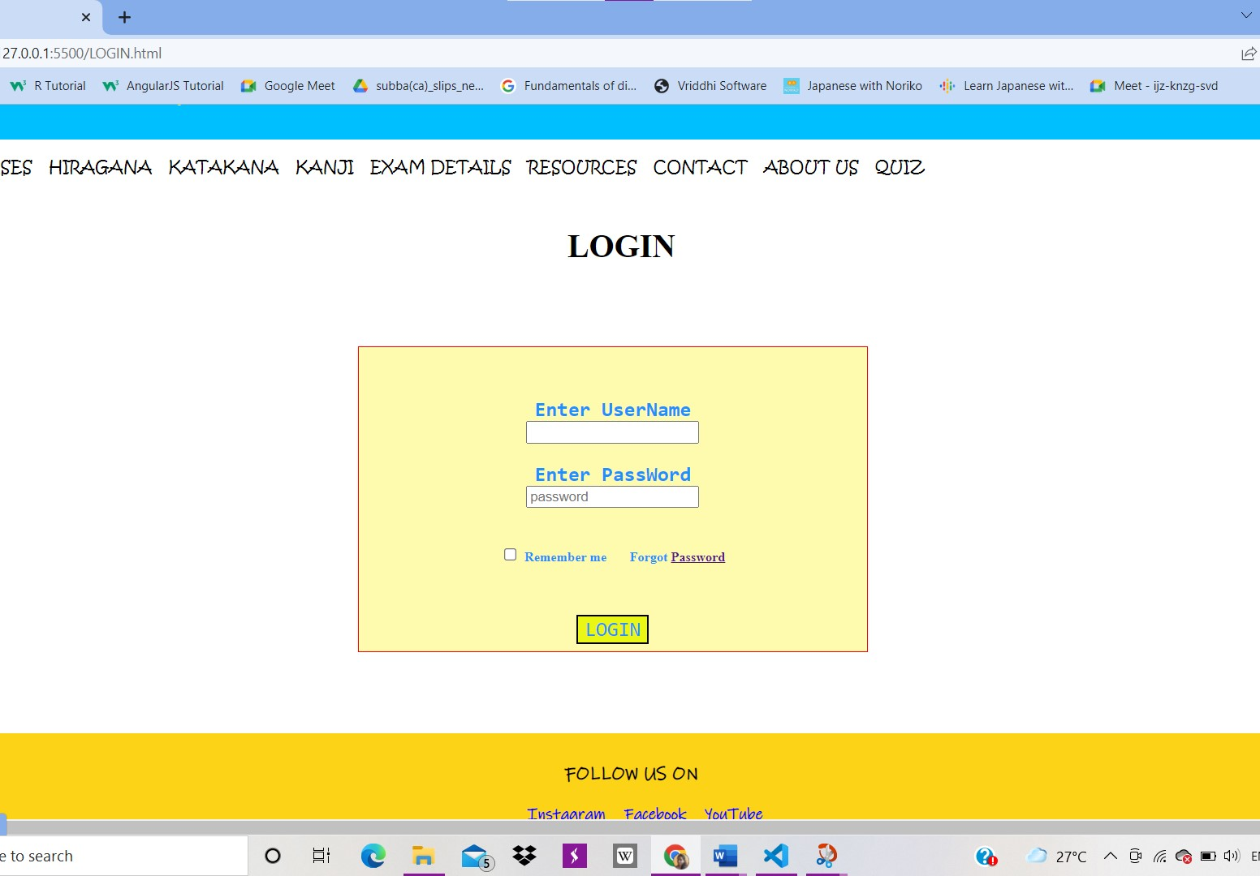
Project analysis slide 2
Login

Slide 33
Limitations
Learning a new language online maybe challenging for the beginners.
Interactive classes are needed for any new language learning where it becomes easy.

Slide 34
Bibliography
https://www.w3schools.com/
https://smilenihongo.teachable.com/
https://nihongo-e-na.com/eng/site/id345.html#group=nogroup&photo=7
https://youtu.be/2jwdyO_UunE

Slide 35
Thank You

